Slide 1
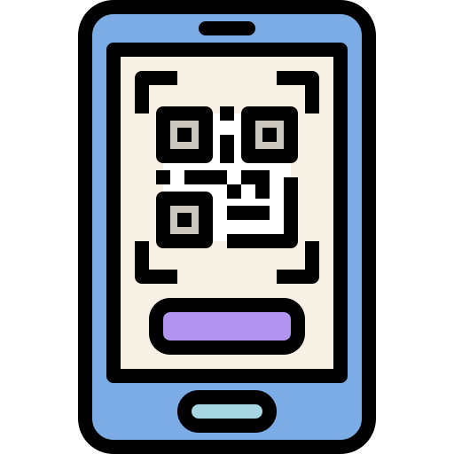


SCDF Emergency QR
108 Devs Team
Daniel Kwang, Joshua Lim, Charles Goh, Ernest Oh, Henry J.

Slide 2



Current problems
(Emergency/Non-emergency Response)
False Alarms
Slow Response
Bystander’s Inability to help

Slide 3
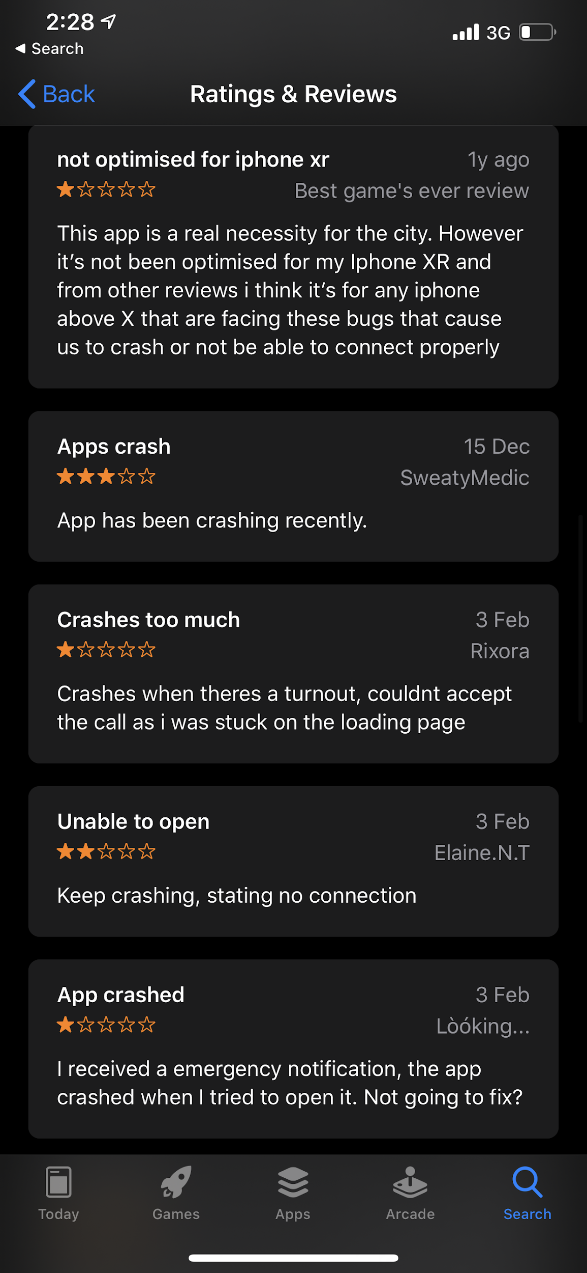
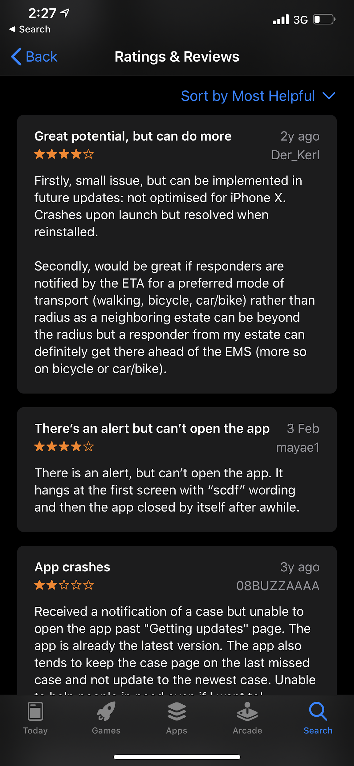
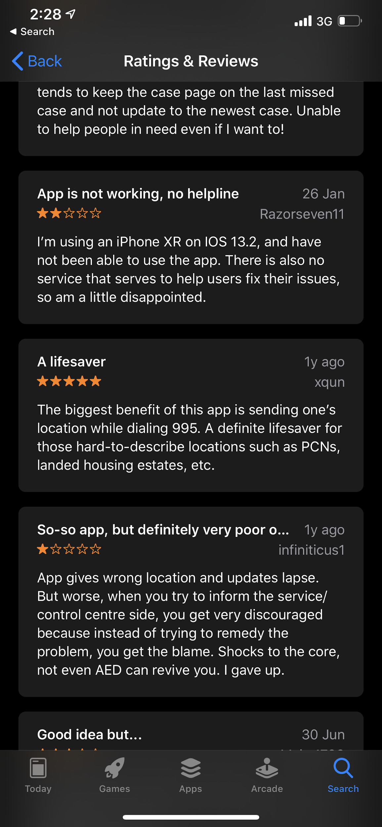
Current problems with Responses
myResponder App - Good! But needs some improvements
Slow: Need to download the app, spread awareness, and register for an account

Slide 4
Why SCDF Emergency QR?
FAST ADOPTION
NO APP INSTALLATIONS
QUICK RESPONSE DURING EMERGENCIES

Slide 5
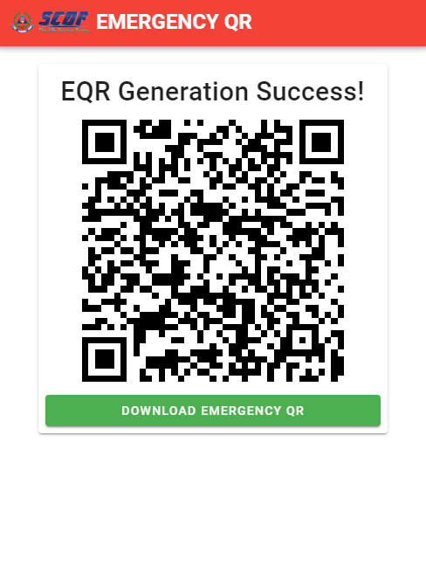
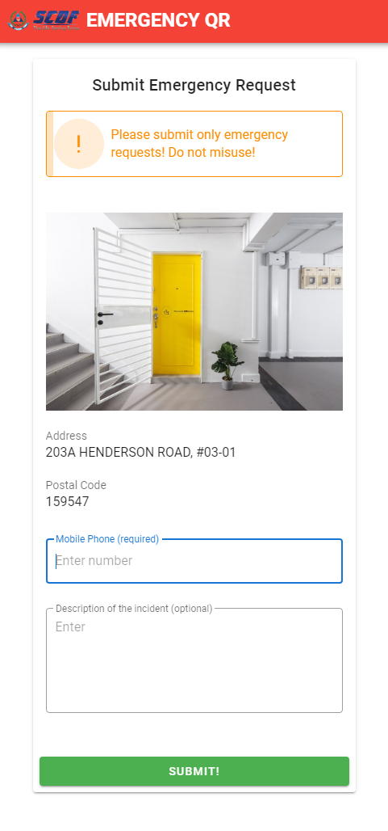
QR For Emergency is an app that helps to generate community QR codes to help SCDF quickly pinpoint the location of emergences

Slide 6


Tools used in app implementation
Database to store data used in creating the app
App Coding

Slide 7



Possible Challenges/Limitations
Small Learning Curve
Education and Adoption
QR Code limited to non-destructive emergencies

Slide 8
Future Projections
IBM cloud technologies (Image recognition of responder to complement the OTP feature to deter people from misusing of our QR app.)
IBM Data Refinery to help us in studying trend of incidents, useful to plan for construction of hospitals / SCDF facilities.
IBM Data Refinery to plan the best and ideal location to place the QR Code based on the number of incidents reported at a specific location
Data can be used to improve facilities for elderly such as slippery floor causing elderly to fall could be resolved.

Slide 9
Conclusion
Through our web app, we aim to promote a smart nation which utilises on technology to help build an emergency ready nation in the future.
Our web app is easy to use and access where people need not fear about the hassle of signing up for various accounts which may lead to loss of data (etc, data breaches).No infringement on the PDPA law.
We also aim to help the vulnerable group(elderly with no next of kin) through the app where people can do incident report quickly with the necessary information such as info of the victims (residential QR).

